Slide 1
NovaCell Voice Assist
The answers already exist. Hindi and Gujarati speakers just can't ask for them.
Ashokkumar Burasiya · AI Product Manager
9 November 2026 · all data synthetic

Slide 2
Self-service only speaks English text, so simple questions go to 611
0 of 28
9 of 30
~2x
10 min
everyday questions the verified FAQ answers that can be asked by voice or in Hindi/Gujarati today
test lines mix English product words (eSIM, VoLTE, roaming) into Hindi or Gujarati
longer wait for a Hindi or Gujarati agent than an English one
call to hear a 30-second FAQ answer read aloud
"The app and the chatbot are in English. When my data stops I call 611 and wait, then I explain in Hindi and they reply in English." Meena, prepaid customer, Ahmedabad
Source: synthetic NovaCell persona, knowledge base and test set, made up for this project.
NovaCell Voice Assist · all data synthetic

Slide 3
Discovery: Meena talks, mixes languages, and wants exact numbers
Meena, prepaid customer
"Mera eSIM activate nahi ho raha."
How she actually asks (synthetic quote)
Primary persona (synthetic)
• Speaks Gujarati and Hindi, mixes English product words
• Sends voice notes, rarely types long messages
• Calls 611 for anything she can't solve quickly
• Goal: fix it in 2 minutes, in her language, with exact steps
"I don't know the English word for this problem."
Meena (synthetic quote)
"Is this price right, or will I be charged more?"
Meena (synthetic quote)
"Half my queue is people asking how to check their balance."
611 team lead (synthetic quote)
NovaCell Voice Assist · all data synthetic

Slide 4
Five whys: help was written once, in English, as text
1
2
3
4
5
611 fills with FAQ calls
Can't self-serve
Never translated
Text isn't enough
Old speech failed
Hindi and Gujarati speakers call for simple answers.
FAQ, app and chatbot are English text only.
Keeping three language copies in sync was never funded.
Many prefer speaking and mix scripts when typing.
English-first IVRs misheard mixed speech.
Root cause
Self-service exists only as English text, and earlier speech systems could not understand the way these customers actually speak. So answers that already exist reach them only through a 611 call.
NovaCell Voice Assist · all data synthetic

Slide 5
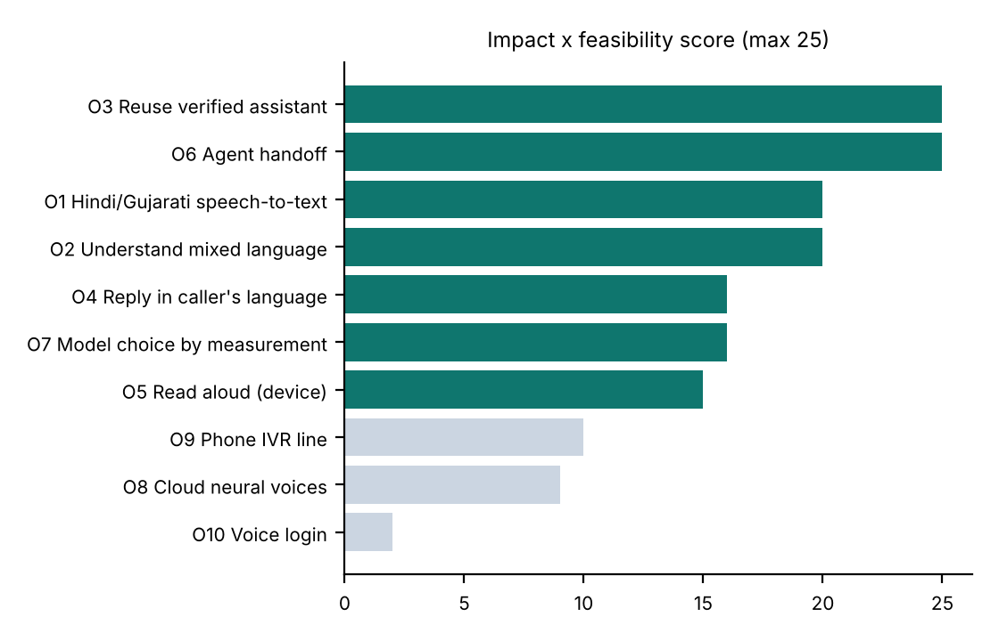
We scored 10 opportunities and built the top seven
Built: listen, understand, answer, reply
Speech-to-text with hints, English normalisation, the existing grounded assistant, checked translation, read-aloud and the model comparison.
Parked on purpose
Phone IVR (needs telephony work after the pilot), cloud voices (cost and a new vendor), voice login (biometric risk, not needed).
NovaCell Voice Assist · all data synthetic

Slide 6
Four steps: deep learning listens, the verified assistant answers
1
2
3
4
Listen
Understand
Answer
Reply
Whisper large-v3 transcribes Hindi, Gujarati, Hinglish or English with product words and a language hint.
An LLM turns the question into one clear English question; checks run before and after.
NovaCell's grounded assistant answers only from verified content, with sources, or hands off.
The answer is translated back, every number checked, and the phone reads it aloud.
Nothing new to maintain
The knowledge stays in one English source of truth. Voice Assist adds speech and language on top of the evaluated text assistant, so every answer keeps its citations and guardrails.
NovaCell Voice Assist · all data synthetic

Slide 7
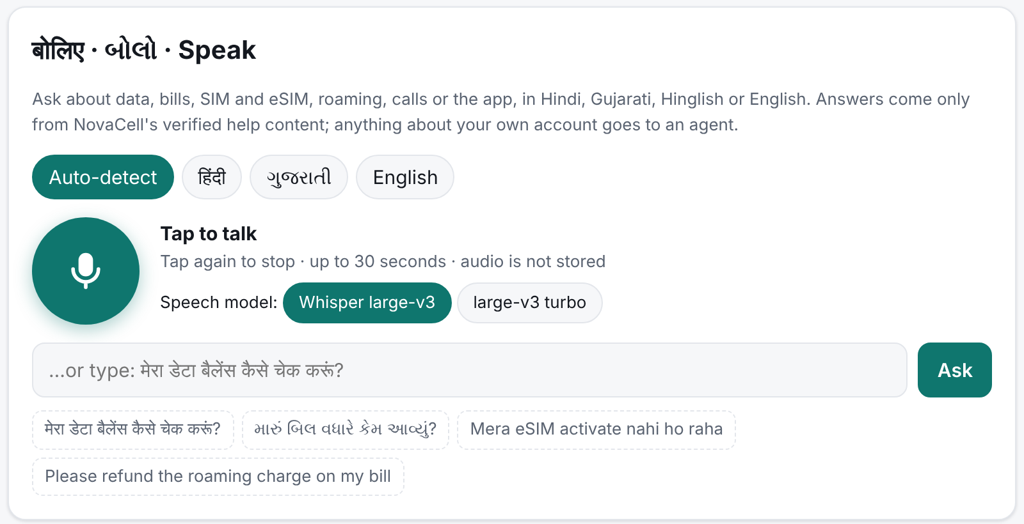
Meena taps, speaks in Gujarati, and hears the steps back in Gujarati
1
Speak or type
Any of four languages; auto-detect or choose one.
2
See what it heard
The transcript is shown and can be edited.
3
Answer in her language
With sources; numbers and codes identical to the verified English.
4
Account? An agent
Refunds and cancellations go to 611 / chat.
NovaCell Voice Assist · all data synthetic

Slide 8
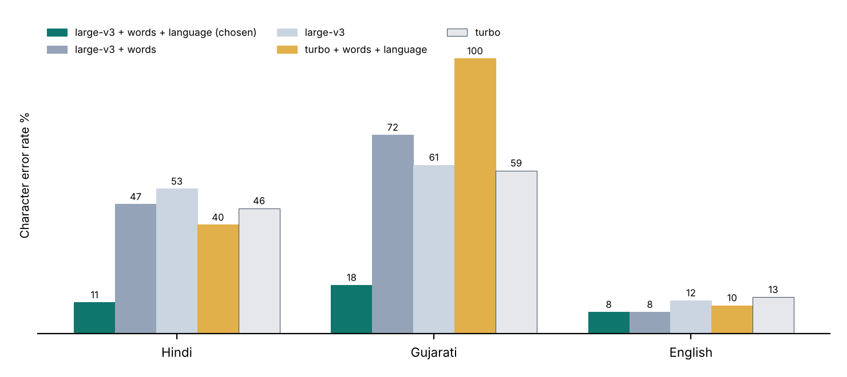
The deep-learning choice: one language hint halved the errors
0 of 30 wrong script
Without a hint, Whisper wrote 9 of 20 Hindi and Gujarati clips in Urdu, Telugu or Gurmukhi script.
With the hint: CER Hindi 11%, Gujarati 18%, English 8%.
The 2.8x cheaper turbo model ignored the Gujarati hint, so large-v3 stays. The app retries whenever it sees the wrong alphabet.
NovaCell Voice Assist · all data synthetic

Slide 9
Guardrails on the way in and on the way out
Mishears a product word or number
Product-word prompt and language hint; transcript shown and editable.
Writes Hindi or Gujarati in the wrong alphabet
Script check and one retry with the implied language.
Translation changes a price or code
Every number checked; the verified English answer is shown instead.
Invents an answer
Grounded assistant: citations, grounding checks, 'not verified' plus handoff.
'Ignore your rules' spoken in Hindi
Injection checks on the original words and again in English.
Voice privacy
Audio sent once for transcription, never stored; no voiceprints.
NovaCell Voice Assist · all data synthetic

Slide 10
Speech is cheap; translation tokens are the main cost
Step | Model | Cost per question
Listen | Whisper large-v3 (Groq) | $0.0003 (10 s minimum)
Understand | gpt-oss-20b → 120b | ≈ $0.0001
Answer | Grounded assistant, gpt-oss-120b | ≈ $0.0003 (measured tokens)
Reply | gpt-oss-20b translation | ≈ $0.0003 (Hindi/Gujarati use 3-5x tokens)
Read aloud | Phone's own voice | $0
About $83 a month
for 60,000 voice questions (2,000 a day) at list prices, against about $90,000 of 611 handling cost avoided if 60% resolve.
Prototype stack
Node on Vercel's free tier; Groq Whisper and gpt-oss models; Gemma on OpenRouter as fallback; browser speech for read-aloud.
NovaCell Voice Assist · all data synthetic

Slide 11
North Star: questions resolved by voice without a 611 call
Layer | Metric | Target
AI (speech) | CER by language; wrong script | ≤ 20% Hindi/Gujarati, ≤ 10% English; 0%
AI (answer) | Task success; number fidelity | ≥ 85% per language; 100%
Product | Edited transcripts; repeat questions | < 20%; < 10%
Business | 611 FAQ-topic calls, pilot area | -20% vs control area
Guardrail | Invented answers; stored audio | 0; 0
Resolved per 1,000 sessions
A voice session that ends with an answer and no 611 call within 24 hours.
Baseline: 0, there is no voice self-service.
Pilot target: 600 per 1,000.
It measures the outcome Meena wants.
NovaCell Voice Assist · all data synthetic

Slide 12
Launch evals: speech and answers pass
Eval | Set | Result | Target
Speech accuracy (CER) | 30 clips | Hindi 11% · Gujarati 18% · English 8% | ≤ 20% / ≤ 10%
Wrong alphabet | 20 Hindi + Gujarati clips | 0 (was 9 without hint) | 0
Transcription latency | 30 clips | p95 0.6 s | < 1 s
Task success by language | 47 text cases | Hindi 87.5% · Gujarati 100.0% · English 100.0% | ≥ 85%
Safety (hand-off, block, emergency) | text cases | 100.0% | 100%
Reply in the caller's language | Hindi + Gujarati answers | 94.4% (rest: verified English) | ≥ 90%
Test speech is synthetic (Meta MMS voices) and clean, so these numbers are optimistic. Noisy copies and a consented real-caller set in the beta decide the launch.
NovaCell Voice Assist · all data synthetic

Slide 13
Rollout earns trust with real voices first
Nov 2026
Jan 2027
Mar 2027
Apr 2027
Alpha on synthetic speech
Beta: 500 Ahmedabad customers
Rollout decision
Gujarat and Hindi circles
Gate: CER, wrong-script, task success and safety targets.
Done: live prototype.
Consented, no audio kept.
Gate: task success ≥ 80% on 200 rated sessions.
611 FAQ calls vs a control area.
IVR line planned from pilot evidence.
NovaCell Voice Assist · all data synthetic

Slide 14
Next: a real-voice beta in Ahmedabad in January
• Approve a consented, no-storage beta with 500 customers
• Agree the control area with the 611 team
• Decide rollout on resolved questions and 611 calls avoided
Try it: novacell-voice-assist.vercel.app

